Slide 1
Graph-Guided Reasoning for Multi Hop Question Answering in Large Language Models
December 21, 2023

Slide 2

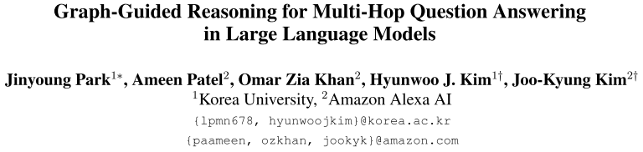
Motivition
LLMs still struggle with reasoning over challenging problems that require complex multi-step reasoning
Two issues in reasoning paths generated by CoT when dealing with multi-step reasoning:
(i) Generating rationales irrelevant to the question.
(ii) Unable to compose subquestions or queries for generating/retrieving all the relevant information.
e.g.
Question: When did the director of film Hypocrite (Film) die?
Subquestions:
1)Who directed Hypocrite (Film)?
2)When did Miguel Morayta die?
Notes:
此工作的motivation主要有两方面
在推理多跳问题时仍然存在困难，因为 CoT 生成的推理有时与问题无关，或者产生幻觉。 另一方面，以前的 CoT 方法偶尔会错过生成足够的子问题来获取相关信息，因为它们主要依赖于上下文学习将原始问题分解为子问题

Slide 3
TASK definition
(1) the reasoning paths need to be in the correct order
(2) the rationales in the reasoning paths need to be simple enough so that the language model can easily understand
(3) the rationales need to be relevant to the question
and informative to obtain the answer.
Decompose the complex problem into multiple subquestions and verifying generated intermediate rationales with guidance based on the graph structure.

Slide 4
METHOD
step1.
construct the question graph by extracting the triplets from the question with in-context learning.
step 2.
substep (1).
generate an intermediate question based on the triplet of the question graph.
e.g. Question: When did the director of film Hypocrite (Film) die?
Question triplets: (‘Hypocrite’, directed by, $1)
($1, death date, $2)
substep (2).
generate an answer for the intermediate subquestion.
substep (3).
validate whether the generated rationale is necessary for solving the question by comparing the rationale triplet with the question graph.
repeat step 2. utill reaching the answer to the original question or the maximum number of reasoning steps.
Notes:
1.将整个问题通过抽取三元组的方式分解为一个待完成的知识图
2.每次选择只含有一个变量实体的三元组来构造问题
3.让大模型根据构造的问题来进行回答（会用到knowledge retrieve）
4.检测回答的答案是否与知识图中的信息相关

Slide 5
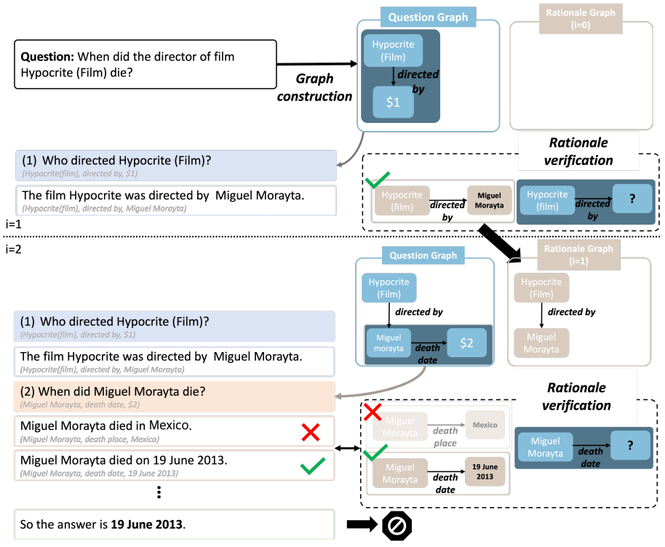
METHOD
疑似没画全
step 1.
step 2.
substep (1)
substep (2)
substep (3)
Notes:
最后汇总原始问题和所有的子问题及其回答，再加上“So the answer is”来获取最终答案。

Slide 6
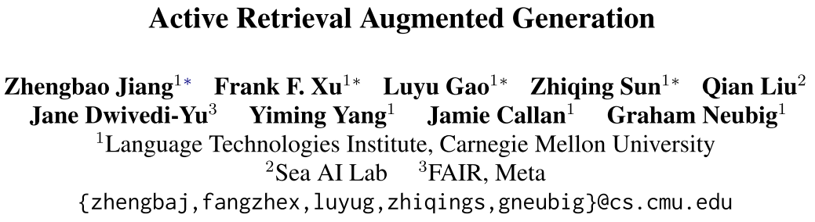

METHOD (validatION)
extract rationale triplets from a generated rationale by prompting the LLM with a rationale sentence as an input.
each generated rationale triplet is validated by aligning it with the question graph.
If the rationale is rejected, return to the subquestion generation step.
②
relation + object/subject
equals
①
Before validation
If cofidence(answer) < threshold:
regenerate an anwser with retrieval augmentation
If cofidence(answer) still < threshold:
remove the current subquestion and try generate alternative subquestions
Notes:
利用理据的置信度来验证它。 首先让 LLM 生成答案并检查置信度。 与 FLARE 类似，如果置信度低于阈值 (0.7)，则我们使用检索增强来再次生成答案。 在这里，如果即使使用检索增强，答案也不再有把握，我们将删除当前的子问题，并尝试使用最多 3 次的随机解码生成替代子问题。

Slide 7
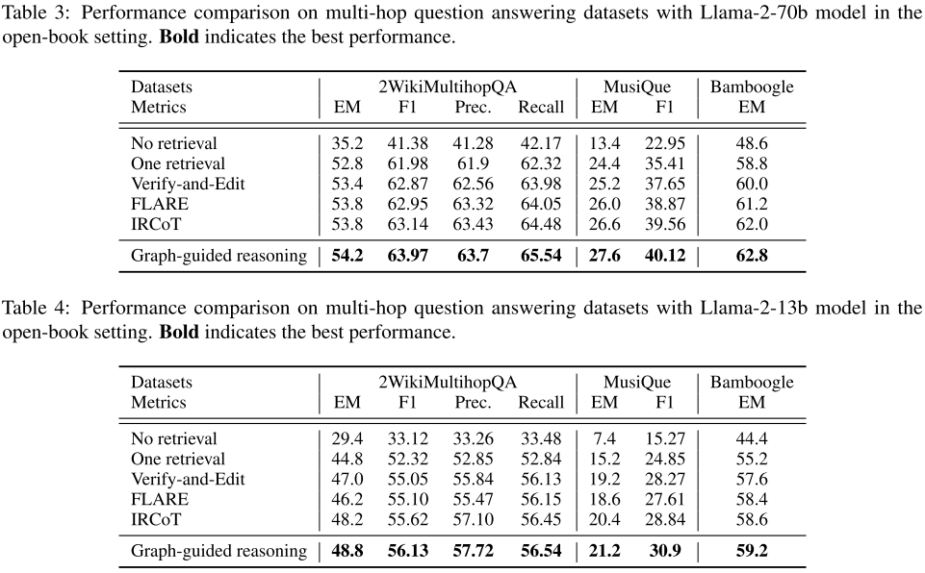
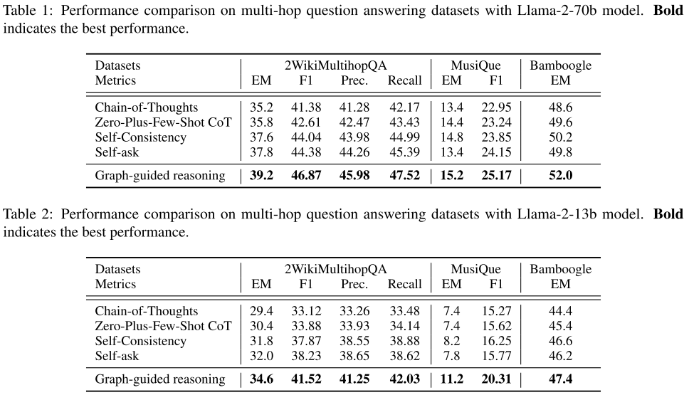
RESULT
Open-book setting
(external knowledge)
Without knowledge retrieval
Notes:
以0.7的解码温度对5条推理路径进行采样，并进行多数表决以获得答案。

Slide 8
QESTION & INSPIRATION
Q:
The article mentioned the importance of the order in which subtasks are completed in the task definition, but didn’t explain how to limit the order.
I:
Decompose complex problems into a knowledge graph pending completion, using known conditions as clues to gradually fill in the graph and ultimately arrive at an answer.
Notes:
文章中提到了任务定义中子任务完成顺序的重要性，但没有解释如何限制顺序，后来我自己想明白了但还是放了上来
每次子问题被回答都会填补图中的空白，同时每次只选择含有一个变量实体的三元组作为子问题生成的载体，进而间接控制了顺序
将复杂问题解构为一个待完成的知识图谱，将已知条件作为线索来逐步补全图谱，最终得到答案

